Slide 1

Bayesian Modeling of Dynamic Scenes for Object Detection
Kevin Cherry
Robert Firth
Manohar Karki
Notes:
K

Slide 2
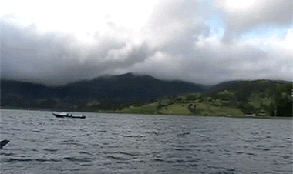
Problem Definition
Accurate detection of moving objects within scenes with dynamic background, in scenarios where the camera is mostly stationary.
Notes:
K

Slide 3
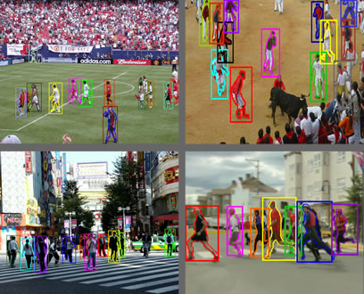
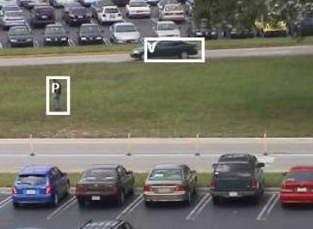
Motivation
Prerequisite for object tracking and recognition
Notes:
K

Slide 4
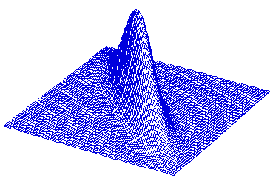
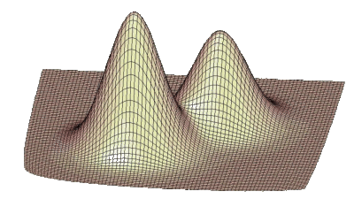
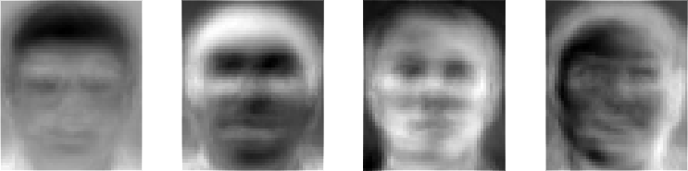
Previous Work– modelling intensity
Methods that employ local (pixel-wise) models of intensity
Methods that have regional models of intensity
Notes:
K

Slide 5
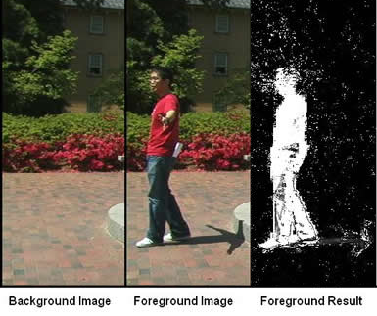
Previous Work – Background Subtraction
Naïve approach: | frame_{i} – background | > threshold
Better: | frame_{i} – μ | > kσ
Notes:
R

Slide 6

Background – Bayes' theorem
$$p\left(ℒ | \hat{x}\right)=\frac{p\left(\hat{x} | ℒ\right)p\left(ℒ\right)}{p\left(\hat{x}\right)}$$
APPENDIX: EXAMPLE
Notes:
M Bayes’ theorem gives you the actual probability of an event given the measured test probabilities

Slide 7
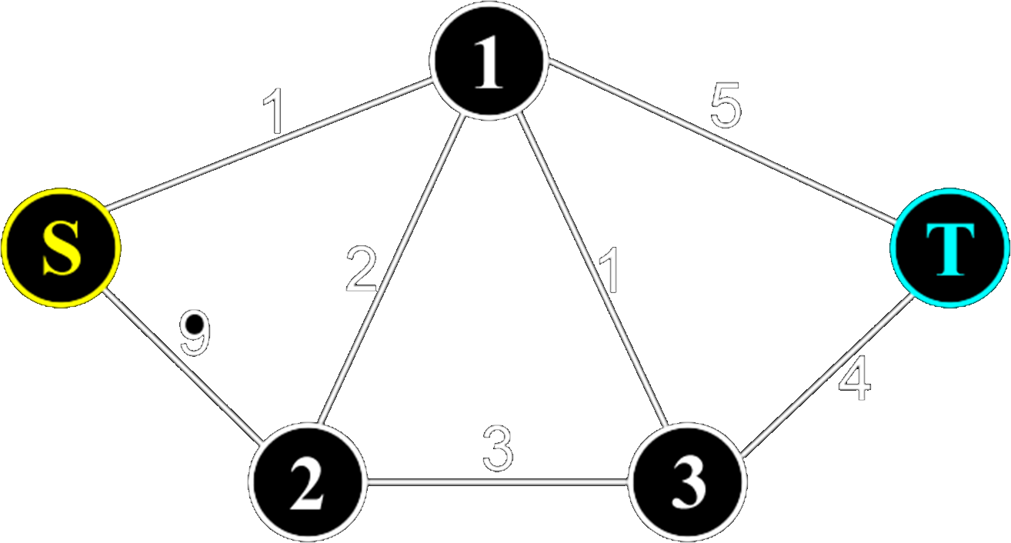
Background – Minimum Cut
Notes:
M - Minimum cut of a directed, weighted graph partitions the graph into two disjoints sets S and T, where s ∈ S and t ∈ T, where s is a source and t is the sink. The cost that we are minimizing is the sum of the weights of the edges that connect S and T.

Slide 8
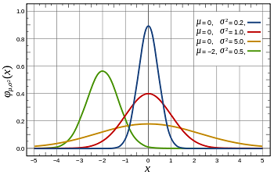
Background – Probability Density Estimator (parametric)
Notes:
R

Slide 9
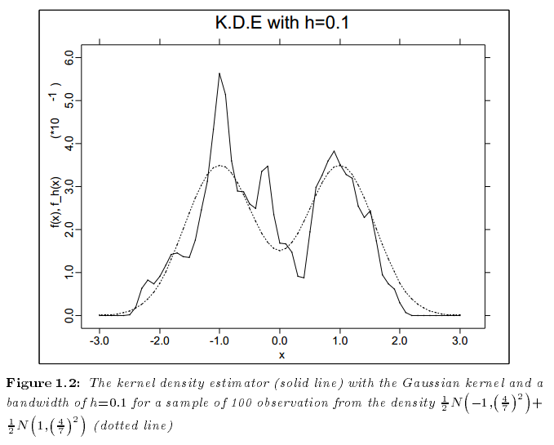
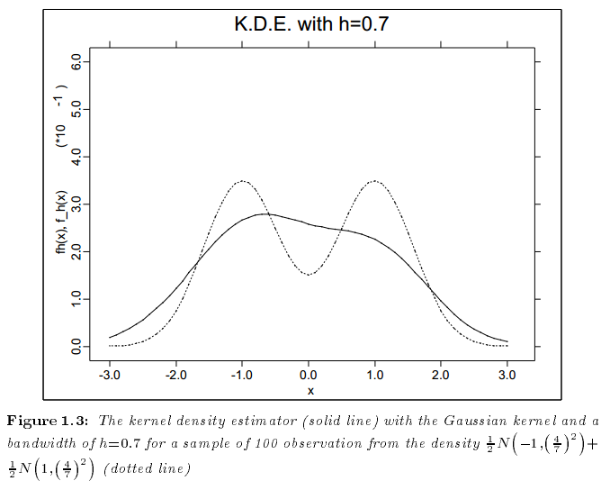



Background – Kernel Density Estimator (nonparametric)
$${\hat{f}}_{h}\left(x\right)=n^{−1}\sum_{i=1}^{n}{K_{h}\left(x−x_{i}\right)}$$
$$H= h^{2}I$$
$H=diag(h_{1}^{2},h_{2}^{2}$,…, $h_{d}^{2})$
Notes:
R - Kernel must be symmetric and of unit area
Turlach, Berwin. “Bandwidth Selection in Kernel Density Estimation”.

Slide 10





Background - Bandwidth Estimation
Mean Squared Error:
Balloon Estimator:
Sample-point Estimator:
For computation reduction,
OR,
APPENDIX – Bandwidth Matrix Classes
$$MSE\left\{{\hat{f}}_{H}\left(x\right)\right\}=E\left\{{\left[{\hat{f}}_{H}\left(x\right)−f_{H}\left(x\right)\right]}^{2}\right\}$$
$$f\left(x\right)=\frac{1}{n}\sum_{i=1}^{n}{φ_{H(x)}\left(x−x_{i}\right)}$$
$$f\left(x\right)=\frac{1}{n}\sum_{i=1}^{n}{φ_{H(x_{i})}\left(x−x_{i}\right)}$$
$$H= h^{2}I$$
$H=diag(h_{1}^{2},h_{2}^{2}$,…, $h_{d}^{2})$
Notes:
K

Slide 11
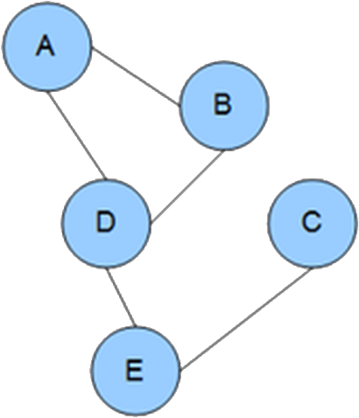
Background: Markov Random Field
Notes:
K

Slide 12
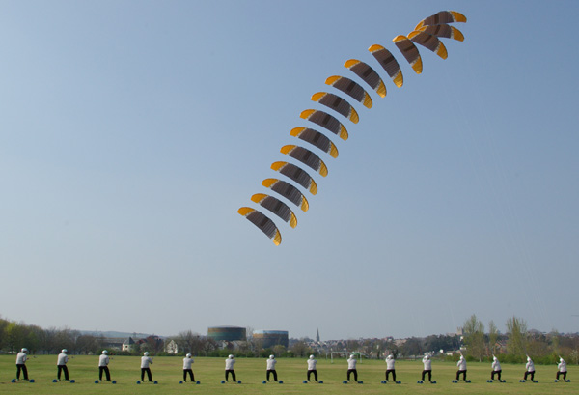
Background– Temporal Persistence
Guy flying kite. 15 consecutive frames merged using Photoshop.
Notes:
M - Interesting objects tend to remain in the same spatial vicinity and tend to maintain consistent colors from frame to frame.

Slide 13
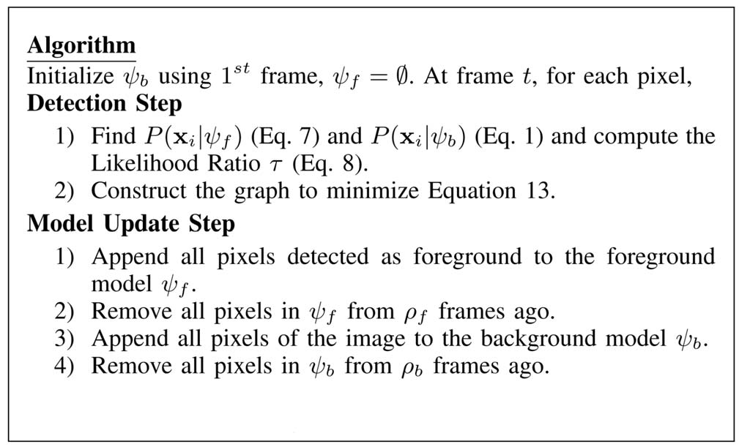
Method Overview
Notes:
M

Slide 14
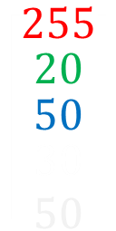
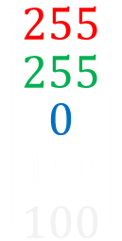

Joint Domain-Range Representation
Domain: (x, y) coordinates
Range: (r, g, b) color values at each (x, y) coordinate
Joint Domain-Range Representation: f_{R,G,B,X,Y} (r, g, b, x, y)
Directly models dependencies between neighboring pixels
Examples:
$$\left[\begin{matrix}255 \\ \begin{matrix}20 \\ \begin{matrix}50 \\ \begin{matrix}30 \\ 50\end{matrix}\end{matrix}\end{matrix}\end{matrix}\right]$$
$$\left[\begin{matrix}0 \\ \begin{matrix}0 \\ \begin{matrix}255 \\ \begin{matrix}0 \\ 10\end{matrix}\end{matrix}\end{matrix}\end{matrix}\right]$$
$$\left[\begin{matrix}255 \\ \begin{matrix}255 \\ \begin{matrix}0 \\ \begin{matrix}100 \\ 100\end{matrix}\end{matrix}\end{matrix}\end{matrix}\right]$$
Notes:
M Paper uses the joint Domain and Range representation of the attributes of each pixel as a single vector containing the RGB values and the location of the pixel on the frame.

Slide 15
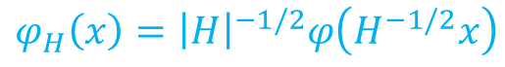
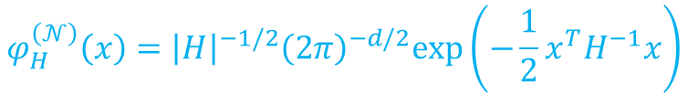
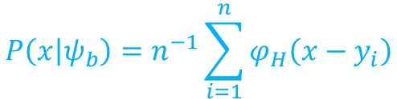
Modeling the Background
$$P\left(x | ψ_{b}\right)=n^{−1}\sum_{i=1}^{n}{φ_{H}\left(x−y_{i}\right)}$$
$$φ_{H}\left(x\right)={\left|H\right|}^{−1/2}φ\left(H^{−1/2}x\right)$$
$$φ_{H}^{\left(𝒩\right)}\left(x\right)={\left|H\right|}^{−1/2}{\left(2π\right)}^{−d/2}exp⁡\left(−\frac{1}{2}x^{T}H^{−1}x\right)$$
|H| = 2666495
|H|^{-1/2} = 0.00061239
Bandwidth
matrix H:
16 0 0 0 0
0 16 0 0 0
0 0 16 0 0
0 0 0 31 0
0 0 0 0 21
Background pixels:
Y[0]= [15, 15, 15, 1, 1];
Y[1]= [10,12,12.8,1,1];
Y[2]= [ 16,1,2,1,1];
Y[3]= [16, 10, 13, 1, 1];
Inverse of H:
0.063 0 0 0 0
0 0.063 0 0 0
0 0 0.063 0 0
0 0 0 0.032 0
0 0 0 0 0.048
x = [16, 14, 15, 2, 1];
d = x – y[0] = [16-15,14-15,15-15,2-1,1-1] = [1,-1,0,1,0]
d^{T}H⁻¹d= 0.1573
Φ_{H} = 0.00061239 * (2π)^{-5/2} * exp(-1/2 * 0.1573) = 5.72 x 10⁻⁶
P(x | ψ_{b}) = 4⁻¹* (5.72 x 10⁻⁶ + 1.32 x 10⁻⁶ + 1.58 x 10⁻¹⁰+ 3.26 x 10⁻⁶) = 2.57 x 10⁻⁶
Notes:
R

Slide 16
Method Overview
Notes:
R

Slide 17
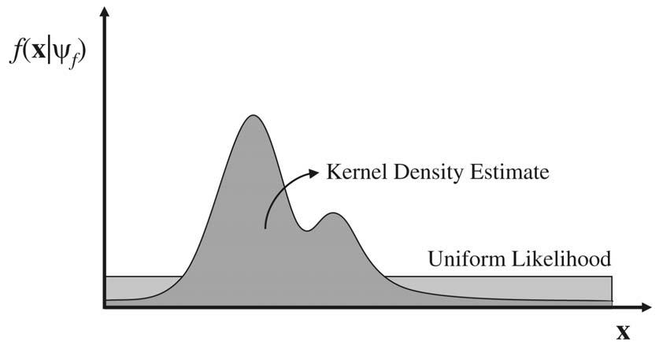

Foreground Modeling
$$P\left(x | ψ_{f}\right)=αγ+\left(1−α\right)m^{−1}\sum_{i=1}^{m}{φ_{H}\left(x−z_{i}\right)}$$
Foreground Probability:
Foreground likelihood function
Notes:
M

Slide 18

Foreground Modeling
$$P\left(x | ψ_{f}\right)=αγ+\left(1−α\right)m^{−1}\sum_{i=1}^{m}{φ_{H}\left(x−z_{i}\right)}$$
Foreground Probability:
Bandwidth
matrix H:
16 0 0 0 0
0 16 0 0 0
0 0 16 0 0
0 0 0 31 0
0 0 0 0 21
Foreground pixels:
y[0]= [15, 15, 15, 1, 1];
Y[1]= [10,12,12.8,1,1];
Y[2]= [ 16,1,2,1,1];
Y[3]= [16, 10, 13, 1, 1];
Inverse of H:
0.063 0 0 0 0
0 0.063 0 0 0
0 0 0.063 0 0
0 0 0 0.032 0
0 0 0 0 0.048
x = [16, 14, 15, 2, 1];
|H| = 2666495 |H|^{-1/2} = 0.00061239
d = x – y[0] = [16-15,14-15,15-15,2-1,1-1] = [1,-1,0,1,0]
d^{T}H⁻¹d= 0.1573
Φ_{H} = 0.00061239 * (2π)^{-5/2} * exp(-1/2 * 0.1573) = 6.188 x 10⁻⁶
P(x | ψ_{f}) = (0.01 * (16*16*16*31*21)⁻¹) + (1-0.01) * (4⁻¹ * 2.57 x 10⁻⁶)
Notes:
R

Slide 19
Method Overview
Notes:
M

Slide 20


Likelihood Ratio Classifier
$$τ=−ln\frac{P\left(x | ψ_{b}\right)}{P\left(x | ψ_{f}\right)}$$
$$δ\left(x\right)=\left\{\begin{aligned}−&1, if τ>κ \\ &1, otherwise\end{aligned}\right.$$
Notes:
M -1 – background +1 – foreground KAPPA – obvious choice would be 0.

Slide 21
Spatial Context
4 Neighborhood Clique
Notes:
M - Rejects idea that the intensity of spatially proximal pixels are independent random variables – they are not! Useful correlation exists.

Slide 22


Likelihood Function
$$l\left(\hat{x} | ℒ\right)=\prod_{i=1}^{p}{f\left(x_{i} | ℓ_{i}\right)=\prod_{i=1}^{p}{f{\left(x_{i} | ψ_{f}\right)}^{ℓ_{i}}f{\left(x_{i} | ψ_{b}\right)}^{1−ℓ_{i}}}}$$
$$ℒ=\left\{foreground, background\right\}$$
Notes:
K - Pixels are not independent random variables – however, given the label, they are conditionally independent. Therefore, this equation holds.

Slide 23



Posterior
$$p\left(ℒ | \hat{x}\right)=\frac{p\left(\hat{x} | ℒ\right)p\left(ℒ\right)}{p\left(\hat{x}\right)}$$
$$= \frac{\left(\prod_{i=1}^{p}{f{\left(x_{i} | ψ_{f}\right)}^{ℓ_{i}}f{\left(x_{i} | ψ_{b}\right)}^{1−ℓ_{i}}}\right) p\left(ℒ\right)}{p\left(\hat{x}\right)}$$
$$p\left(ℒ\right)∝exp\left(\sum_{i=1}^{p}{\sum_{j=1}^{p}{λ}\left(ℓ_{i}ℓ_{j}+\left(1−ℓ_{i}\right)\left(1−ℓ_{j}\right)\right)}\right)$$
Notes:
K

Slide 24
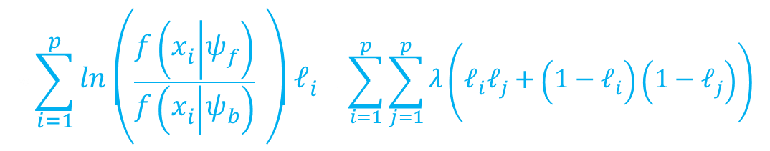





Log Posterior
$$p\left(ℒ | \hat{x}\right)=\frac{p\left(\hat{x} | ℒ\right)p\left(ℒ\right)}{p\left(\hat{x}\right)}$$
$$= \frac{\left(\prod_{i=1}^{p}{f{\left(x_{i} | ψ_{f}\right)}^{ℓ_{i}}f{\left(x_{i} | ψ_{b}\right)}^{1−ℓ_{i}}}\right)exp\left(\sum_{i=1}^{p}{\sum_{j=1}^{p}{λ}\left(ℓ_{i}ℓ_{j}+\left(1−ℓ_{i}\right)\left(1−ℓ_{j}\right)\right)}\right)}{p\left(\hat{x}\right)}$$
$$≈\left(\prod_{i=1}^{p}{f{\left(x_{i} | ψ_{f}\right)}^{ℓ_{i}}f{\left(x_{i} | ψ_{b}\right)}^{1−ℓ_{i}}}\right)exp\left(\sum_{i=1}^{p}{\sum_{j=1}^{p}{λ}\left(ℓ_{i}ℓ_{j}+\left(1−ℓ_{i}\right)\left(1−ℓ_{j}\right)\right)}\right)$$
$$ln$$
$$≈\left(\prod_{i=1}^{p}{f{\left(x_{i} | ψ_{f}\right)}^{ℓ_{i}}f{\left(x_{i} | ψ_{b}\right)}^{1−ℓ_{i}}}\right)+\sum_{i=1}^{p}{\sum_{j=1}^{p}{λ}\left(ℓ_{i}ℓ_{j}+\left(1−ℓ_{i}\right)\left(1−ℓ_{j}\right)\right)}$$
$$≈\sum_{i=1}^{p}{ln\left(\frac{f\left(x_{i} | ψ_{f}\right)}{f\left(x_{i} | ψ_{b}\right)} \right)ℓ_{i} }+\sum_{i=1}^{p}{\sum_{j=1}^{p}{λ}\left(ℓ_{i}ℓ_{j}+\left(1−ℓ_{i}\right)\left(1−ℓ_{j}\right)\right)}$$
Notes:
K

Slide 25
Log Posterior
$$L\left(ℒ | \hat{x}\right)=\sum_{i=1}^{p}{ln\left(\frac{f\left(x_{i} | ψ_{f}\right)}{f\left(x_{i} | ψ_{b}\right)} \right)ℓ_{i} }+\sum_{i=1}^{p}{\sum_{j=1}^{p}{λ}\left(ℓ_{i}ℓ_{j}+\left(1−ℓ_{i}\right)\left(1−ℓ_{j}\right)\right)}$$
Notes:
K

Slide 26
Method Overview
Notes:
K

Slide 27
Optimization: Graph Construction
τ₁ = 0.20
τ₂ = 0.50
τ₃ = -0.07
τ₄ = -0.01
τ₅ = -0.10
λ = 1
Create a weighted graph G = {V, E}, where V = {v₁, v₂, v₂, v₄, v₅, s, t}, where s is the source and t is the sink. If τ_{i} > 0, connect s (source) to v_{i} with weigh τ_{i}. Else, connect v_{i} to t (sink) with weight -τ_{i}. Next, add w(i, j) = λ if v_{i} and v_{j} are neighbors.
 | 0.50
0.20 | -0.07 | -0.10
 | -0.01
Log Ratio Classifier for
4-Neighborhood
2
τ₂ = 0.5
1
1
1
1
1
1
-τ₃ = 0.07
S
1
3
5
T
τ₁ = 0.2
1
1
-τ₅ = 0.1
1
1
1
-τ₄ = 0.01
4
Notes:
R

Slide 28
Why Minimum Cut?
τ₁ = 0.20
τ₂ = 0.50
τ₃ = -0.07
τ₄ = -0.01
τ₅ = -0.10
λ = 1
The minimum cut corresponds to the max flow – and the weights of the max flow are equal to the parameters of the Log Posterior equation.
 | 0.50
0.20 | -0.07 | -0.10
 | -0.01
2
τ₂ = 0.5
1
1
1
1
1
Log Ratio Classifier for
4-Neighborhood
1
-τ₃ = 0.07
S
1
3
5
T
τ₁ = 0.2
1
1
-τ₅ = 0.1
1
1
1
-τ₄ = 0.01
4
$$L\left(ℒ | \hat{x}\right)=\sum_{i=1}^{p}{ln\left(\frac{f\left(x_{i} | ψ_{f}\right)}{f\left(x_{i} | ψ_{b}\right)} \right)ℓ_{i} }+\sum_{i=1}^{p}{\sum_{j=1}^{p}{λ}\left(ℓ_{i}ℓ_{j}+\left(1−ℓ_{i}\right)\left(1−ℓ_{j}\right)\right)}$$
Notes:
R

Slide 29
Method Overview
Notes:
R

Slide 30
Model Update
T = 23
T = 24
T = 25
T = 26
T = 27
T = 28
T = 29
T = next
ρ_{b} = 6
T = 26
T = 27
T = 28
T = 29
T = next
ρ_{f} = 3
Notes:
R

Slide 31
DEMO
Notes:
M

Slide 32
Experimental Setup
All tests run on a 3.06 GHz Intel Pentium 4 with 1 GB RAM.
Video sequences used a 240x360 resolution (0.08 megapixels).
Bandwidth matrix H parameterized as a diagonal matrix with three equal variances for the range and two for the domain, with h_{r} = 16 and h_{d} = 25.
Notes:
K

Slide 33
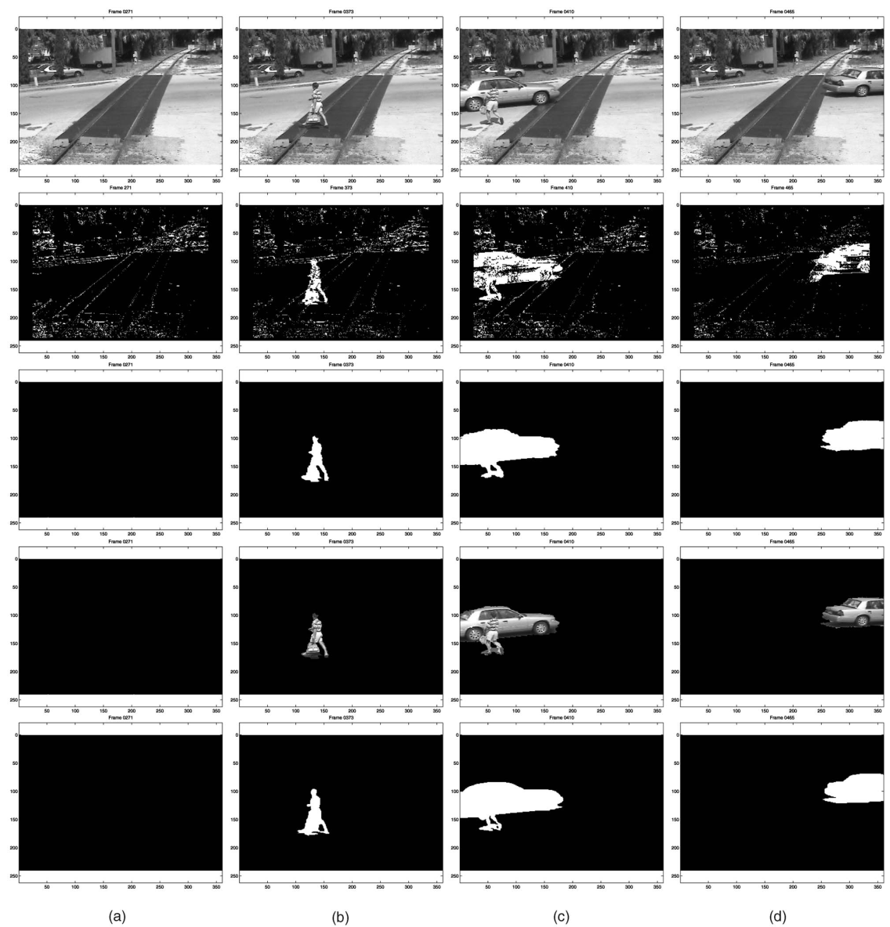
Results
Notes:
K

Slide 34
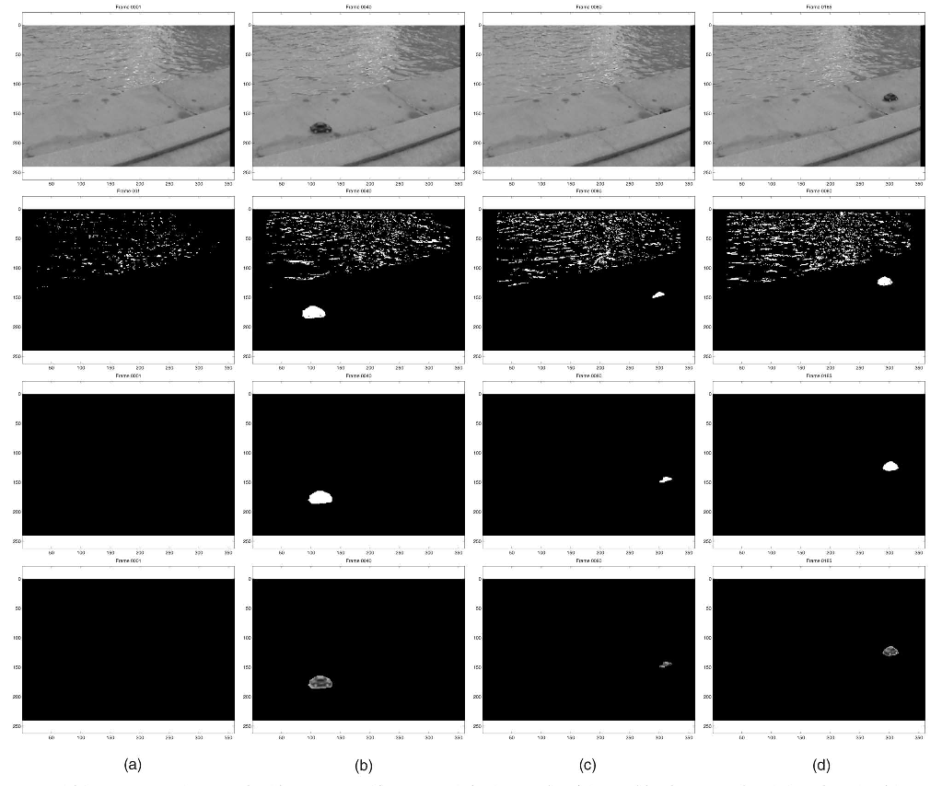
Results
Notes:
K

Slide 35
Results
Notes:
R

Slide 36
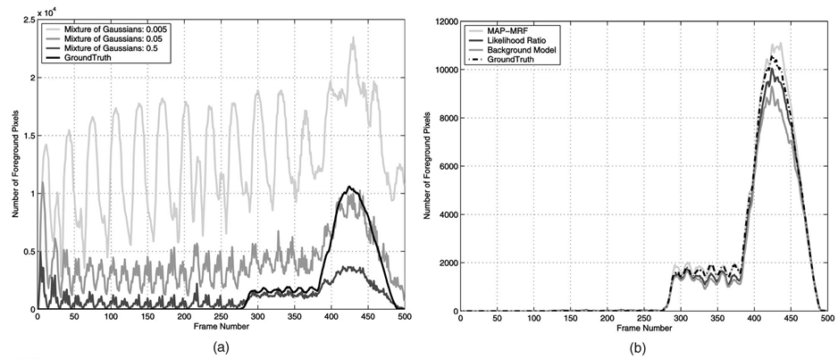
Mixture of Gaussians vs. Nonparametric
Notes:
K

Slide 37
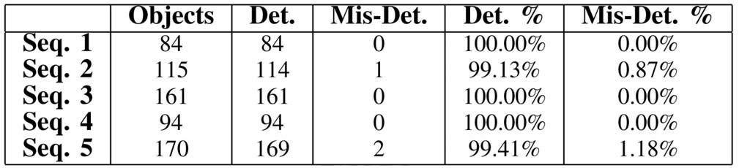
Object Level Detection Rates
Notes:
K

Slide 38
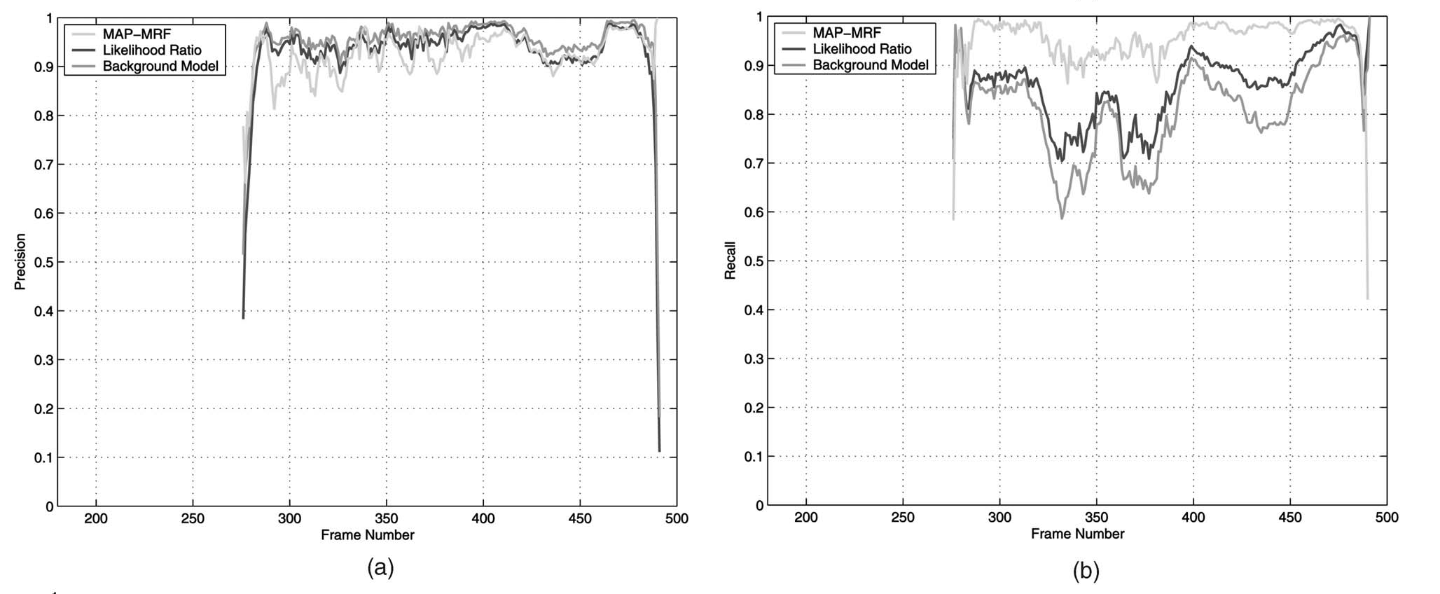




Precision vs. Recall
Precision $=$ $\frac{\# of true positives detected}{total \# of positives detected}$
Recall $=$ $\frac{\# of true positives detected}{total \# of true positives}$
Notes:
R

Slide 39
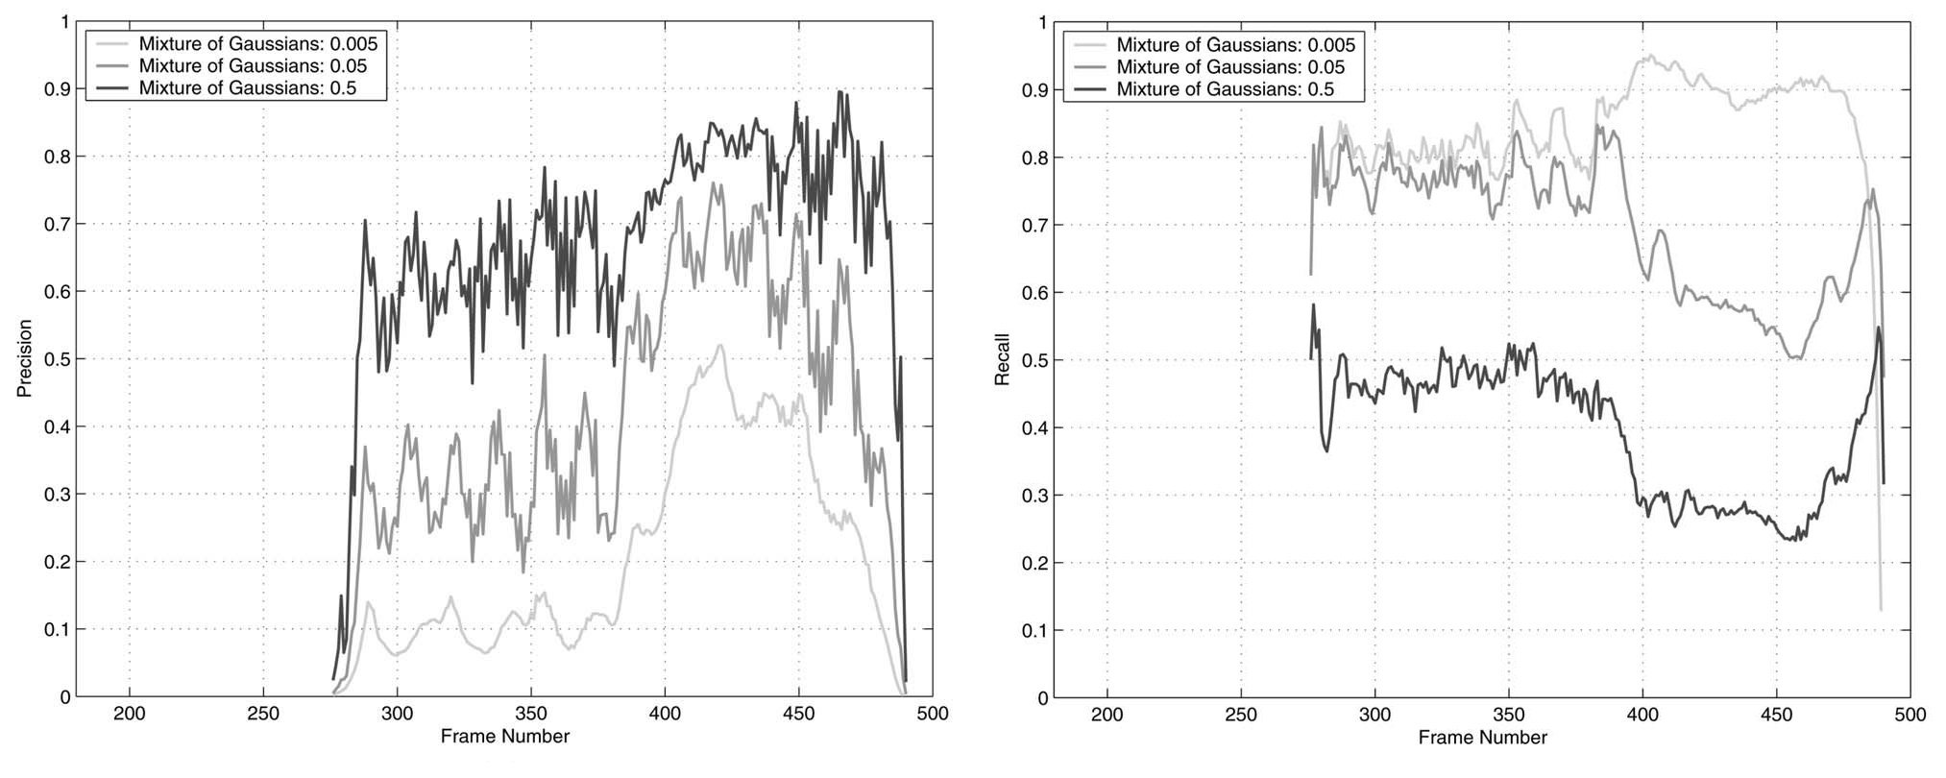
Pixel-level detection recall and precision
Using the Mixture of Gaussians
Precision $=$ $\frac{\# of true positives detected}{total \# of positives detected}$
Recall $=$ $\frac{\# of true positives detected}{total \# of true positives}$
Notes:
R

Slide 40
Discussion
Uses a nonparametric kernel density estimator, which experimentally performs much better than a mixture of Gaussians estimator.
Innovations include using the joint domain-range representation, which allows us to easily incorporate spatial distribution into the decision process.
Also uses temporal persistence as a criterion for detection without feedback from higher level modules.
All likelihoods calculated are used in a MAP-MRF framework to find an optimal global inference of the solution based on local information.
Notes:
R

Slide 41
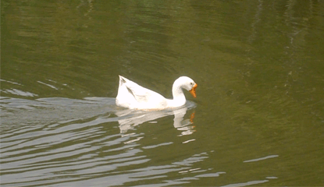
Weaknesses
Notes:
M

Slide 42
Future Work
Image stabilization – this algorithm only works for nominal camera motion
Variant to frame rates, extremely fast moving and slow moving objects.
Illumination Invariant.
Notes:
M

Slide 43

References
Turlach, Berwin. “Bandwidth Selection in Kernel Density Estimation”.
Dr. Gunturk's EE7750 Slides for Parameter Estimation
http://vision.eecs.ucf.edu/projects/Detecting%20and%20Segmenting%20Humans%20in%20Crowded%20Scenes/detection_examples.jpg
http://www.cs.ucf.edu/~sali/Projects/CoTrain/TitleImage.jpg
http://www.philender.com/courses/multivariate/notes2/er9.gif
http://math.bu.edu/people/sray/mat3.gif
Notes:
M

Slide 44

APPENDIX– Mixture of Gaussians

Slide 45
APPENDIX– Mixture of Gaussians

Slide 46



APPENDIX – Bandwidth Matrix Classes
S
positive scalar times the identity matrix
D
diagonal matrix with positive entries on the main diagonal
F
symmetric positive definite matrix

Slide 47
APPENDIX– Proper Kernel for KDE

Slide 48
APPENDIX : Example of Bayes Theorem
Given:
A doctor knows that meningitis causes stiff neck 50% of the time
Prior probability of any patient having meningitis is 1/50,000
Prior probability of any patient having stiff neck is 1/20
If a patient has stiff neck, what’s the probability he/she has meningitis?

